Slide 1
DevSecOps 101
Rashid Shaikh
Network Intelligence India (NII)
Twitter @CyberArmour

Slide 2
Agenda
Introduction
Traditional SDLC (Waterfall)
Introduction DevOps and DevSecOps
DevSecOps Principal.
Important Factor.
Secure SDLC

Slide 3
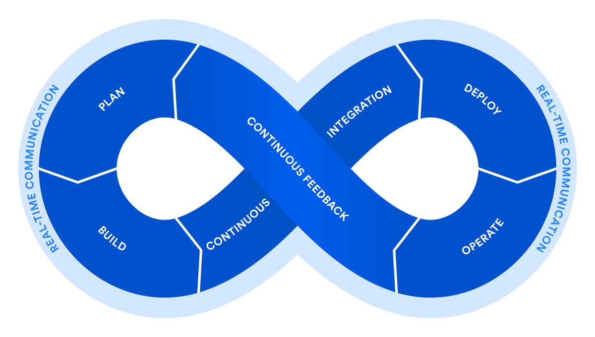
DevOps

Slide 4
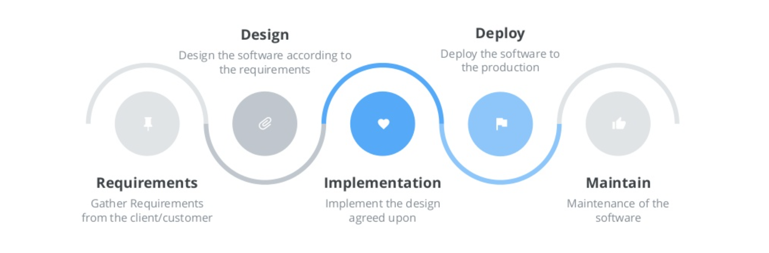
Waterfall Model

Slide 5
Pitfalls Of Waterfall Model
Long Release Cycles
A lot of ”WIP”
Functional Silos
Incredible Rigid

Slide 6
Then Agile Comes In …
Shorter Release Cycle
Smaller Batch Size
Cross Functional Teams
Incredibly Agile

Slide 7
What is DevOps
Set of principles and practice for efficient communication and collaboration (Culture)
Automated Deployment Pipeline (Process)
Supporting Tool chains (Technology)

Slide 8
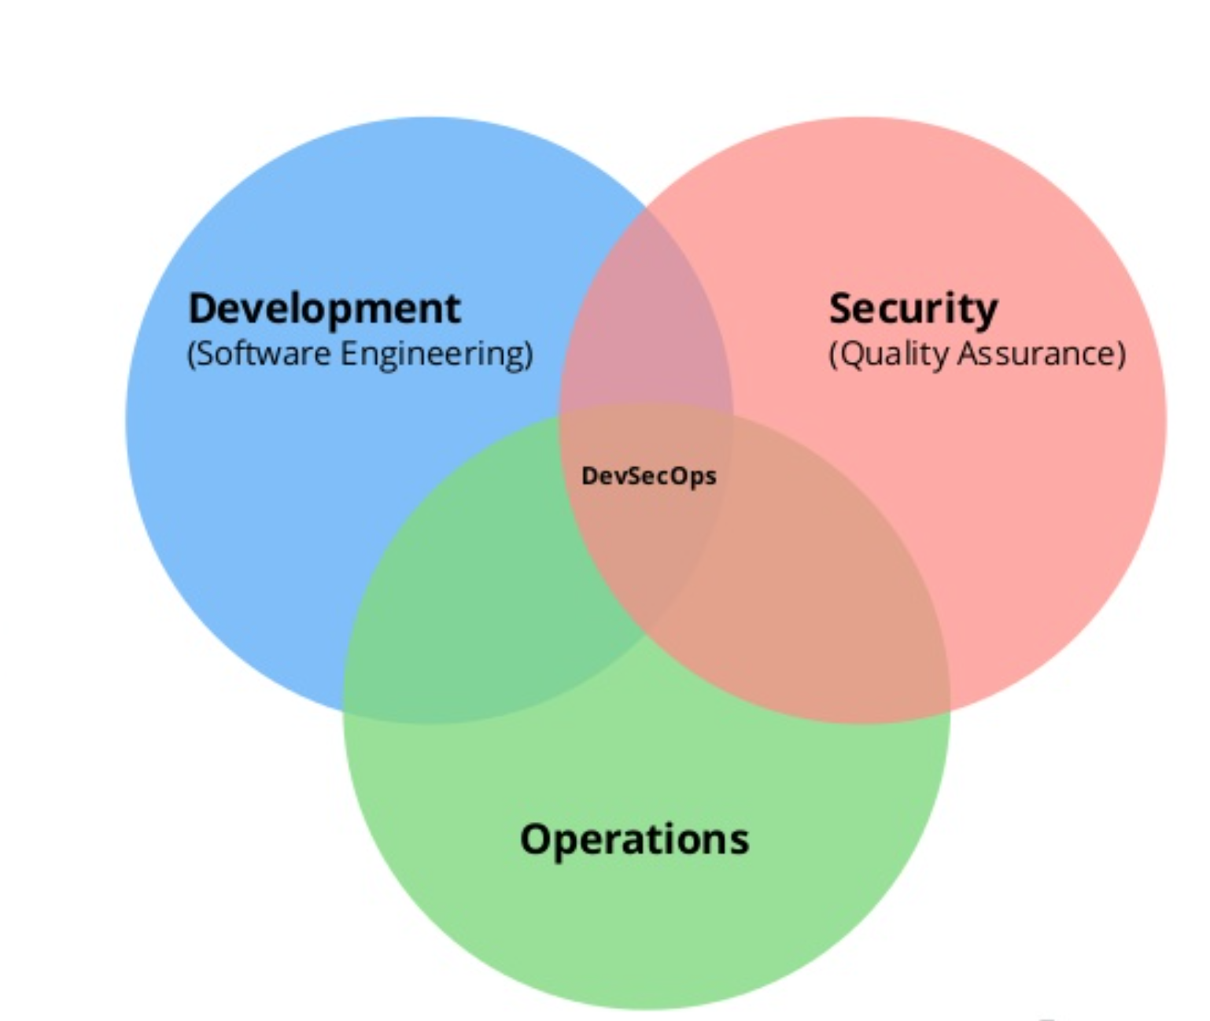
DevSecOps

Slide 9
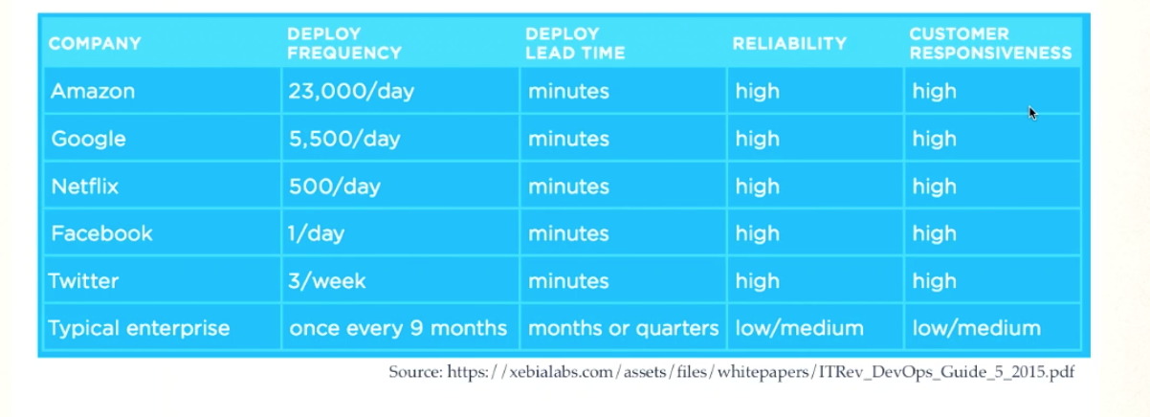
Security Challenges In DevSecOps
Target State
Enable organization to deliver inherently secure software at DevOps Speed

Slide 10
DevSecOps Principles
Culture
Process
Technology

Slide 11
Culture
Communication and transparency
High trust environment
Continues Improvement
Security is everyone responsibility
Automate as much as possible
Everything as code

Slide 12
Process
Training
Understanding Requirements
Architecture & Design
Coding
Testing
Deployment
Post Deployment

Slide 13
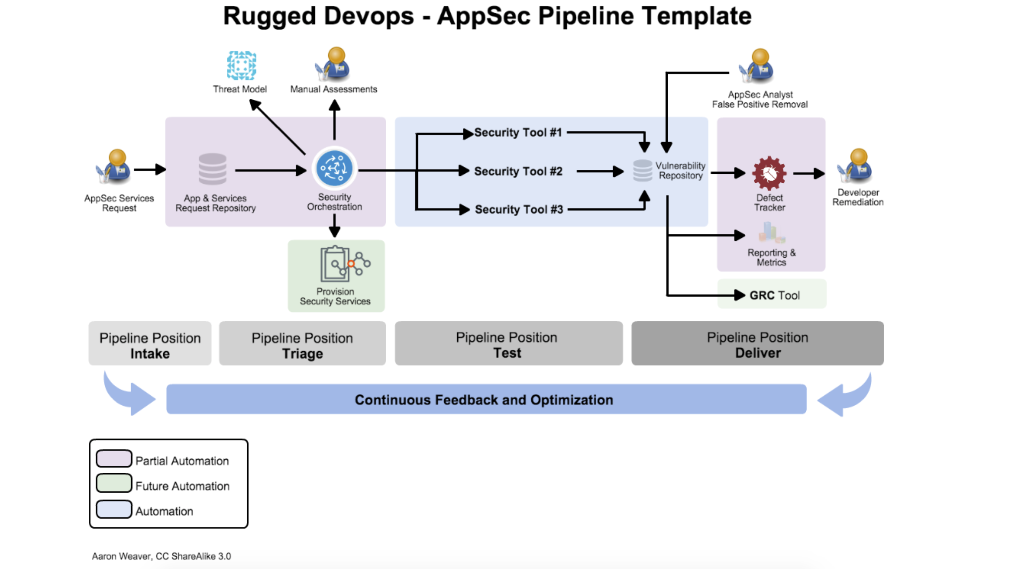
OWASP Appsec Pipeline

Slide 14
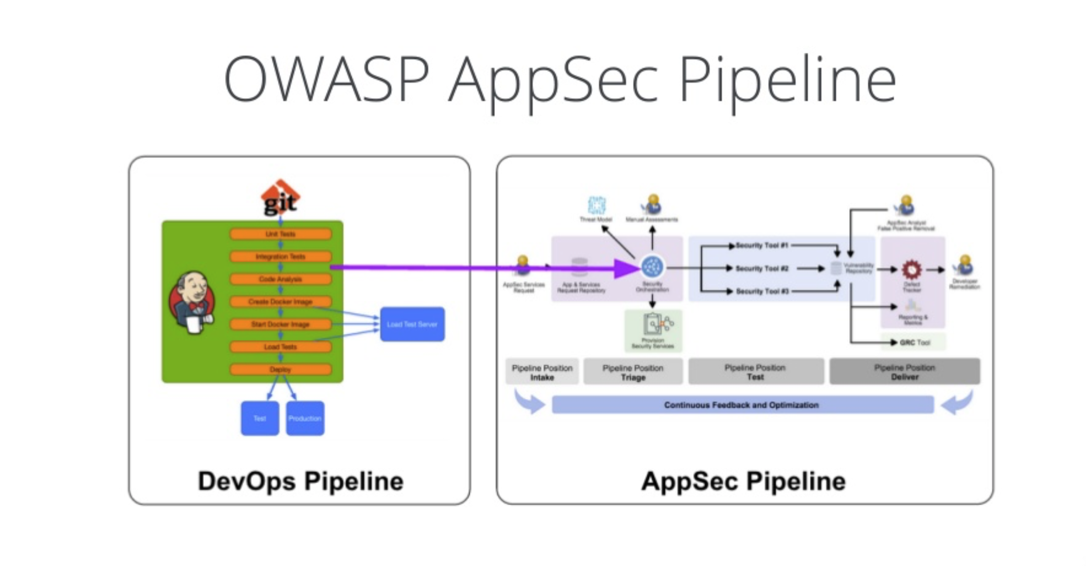
DevSecOps Pipeline

Slide 15
Technology
Requirement
Code (IDE plugins) => SAST
Testing ( Gautlt… burpsuite .. ZAP .. ) => *AST
Configure (Security As a Code)
Maintenance (Patch Management)
Monitoring (Audit, Attacks)

Slide 16
Summary
Waterfall Model
Agile
DevOps
DevOps v/s DevSecOps
DevSecOps Principle (Culture, Process and Technology)

Slide 17
Thanks

